Slide 1


TAGE and Improved TAGE Branch Predictor
210050081 – K . Lokesh
210050160 – V . Raja Gopal
210050161 – V . Mahanth Naidu

Slide 2

Outline
Introduction
Hybrid Branch Predictors
Hashed Perceptron Predictor
TAGE Branch Predictor
Improved TAGE Branch predictor
Comparisons
Analysis

Slide 3
Introduction
Branch predictors are very crucial in a processor as we know that on an average , there will be around 20% branch instructions in a program.
We already have existing procedures for branch prediction like the bimodal predictor, local/global history branch predictor etc.

Slide 4
Can we do better than the existing predictors ?
Some branches are more predictable using local branch history
Some branches are more predictable using global branch history
Some are good with 2-bit predictor, well for biased branches even 1 bit predictor suffices the need .
From the above observations, there is heterogeneity in prediction of branches .
So, why don’t we exploit this idea of heterogeneity and create a new branch predictor ?
That’s where hybrid branch predictor (heterogeneous branch predictor) kicks in .

Slide 5
Hybrid Branch Predictors
Generally, our idea is to use more than one type of branch predictor and choose the best among them .
E.g. Tournament predictor, PPM predictor ,Tage predictor, Improved Tage predictor ( Ltage )
Advantages:
better accuracy ( that’s our purpose though )
Increasing the speed of the predictor
E.g. let’s assume that initially we have a global history predictor of large history length ,we want to use it over some branches which can be easily dealt with 2 bit predictor. If we combine the above 2 predictors instead of taking time to memorize the history for this global predictor and map it to a certain outcome, we can directly use 2 bit predictor.
Disadvantages:
Need a selector to choose a certain predictor based on accuracy.
Increase in latency (due to hardware)

Slide 6
Hashed Perceptron Predictor
Generally, the idea is to use a single layered perceptron to predict the outcome of the branch.
Each branch is associated with a perceptron, a perceptron is the weight vector.
Algorithm:
Here the weight vector corresponds to the bits in global history register
How much correlation does a bit is with the direction of branch
If it's a positive correlation then the weight is largely positive
If it's a negative correlation then the weight is largely negative
Input vector is global history register bits with a change i.e, replace all 0’s with -1
Now calculate the dot product of the weight vector and input vector and add a threshold value
If the final value is greater than 0 then output is 1 else 0.

Slide 7
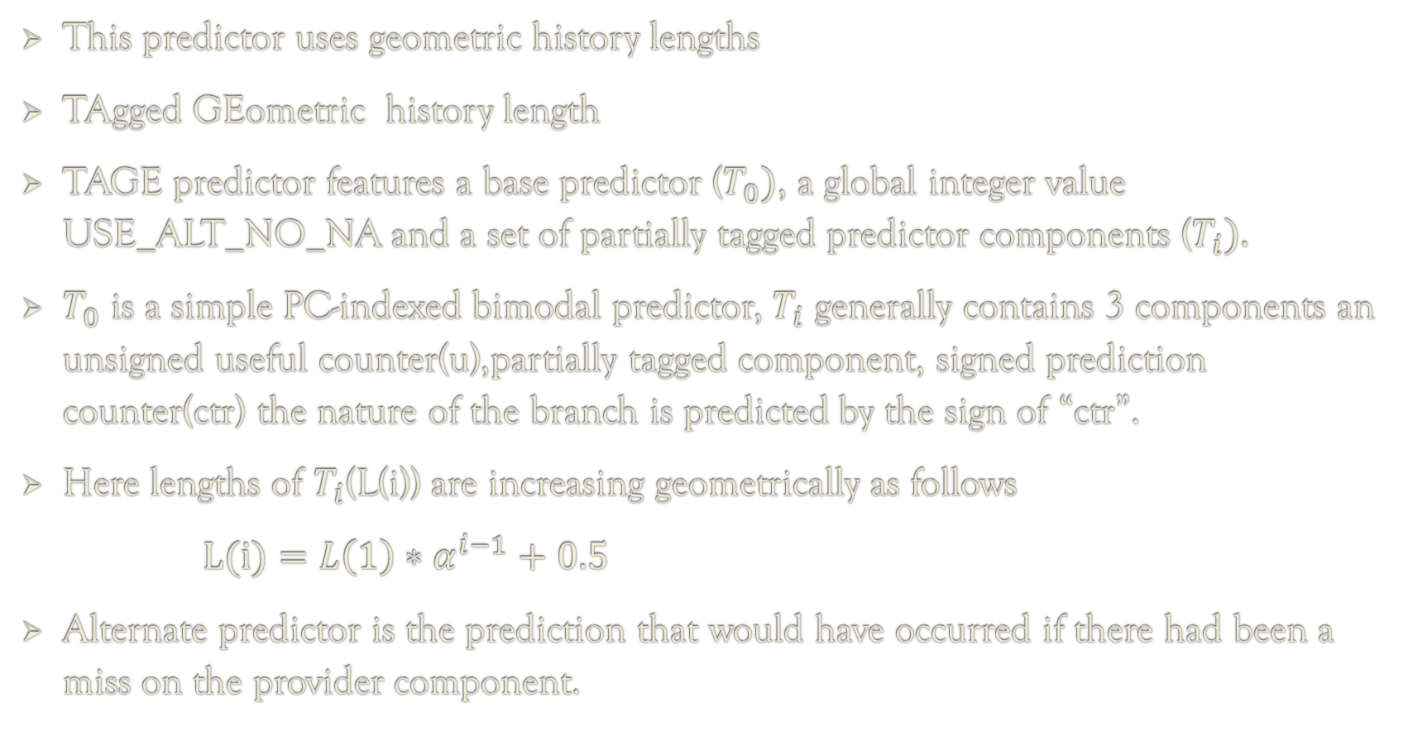
TAGE Branch Predictor
This predictor uses geometric history lengths
TAgged GEometric history length
TAGE predictor features a base predictor ($T_{0})$, a global integer value USE_ALT_NO_NA and a set of partially tagged predictor components ($T_{i}).$
$T_{0}$ is a simple PC-indexed bimodal predictor, $T_{i}$ generally contains 3 components an unsigned useful counter(u),partially tagged component, signed prediction counter(ctr) the nature of the branch is predicted by the sign of “ctr”.
Here lengths of $T_{i}$(L(i)) are increasing geometrically as follows
$L(i)=L\left(1\right)∗α^{i−1}+0.5$
Alternate predictor is the prediction that would have occurred if there had been a miss on the provider component.

Slide 8
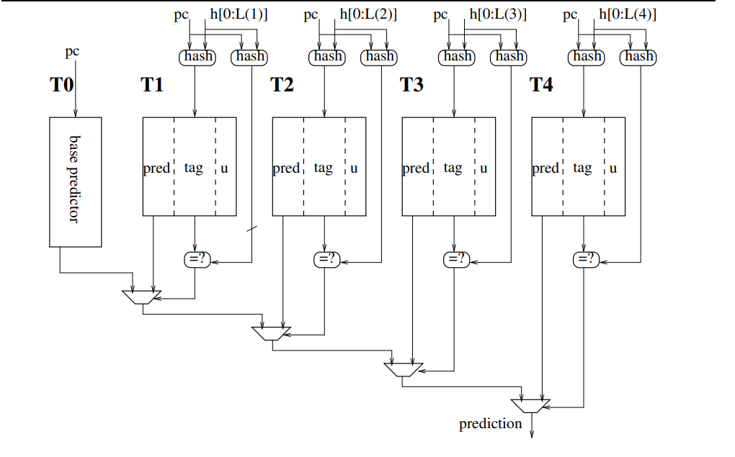
A base predictor (bimodal predictor) and several tagged predictor components indexed with increasing lengths in geometric progression

Slide 9
Updating Policy of PPM-like Predictor
Step 1:
If X is the provider component , then we update the 3-bit counter on bank X i.e , the counter is incremented if the branch is taken and decremented otherwise . It saturates at the value 7 and 0 .
Step 2:
In the case of mis-prediction , new entries were allocated . If X < M , we first read the u bits of all the banks from X+1 to M , if all the u bits are set then we randomly "steal" an entry from any one of the bank from X+1 to M . Otherwise, if at least one among the u bits is reset, we “steal” only the entries which have their u bit reset .
Step 3:
The new entry will be initialised with the computed tag of current branch , the associated u bit is reset and moreover the 3-bit counter will be set to 3 ( weakly not taken ) or 4( weakly taken )

Slide 10
Updating Policy of PPM-like Predictor
Step 4:
If X > 0 and final prediction was correct , then both m bits in bank 0 and u bits in X are set otherwise they were reset .
Step 5:
If the bimodal is wrong , then setting u bits in bank 0 indicates that this entry can't be stolen and setting m bits in bank X indicates that branch outcome correlates with global history value .
Step 6:
If the bimodal is correct , this happens when its outcome not correlates with the global history value means we are allocating many useless entries . Hence , m bits in bank 0 were reset . Moreover , we reset the u bit to indicate that the entry has not been proven useful, so it can be stolen if another branch claims the entry .
This PPM-like branch predictor shows relatively more mis-predictions when compared to the Tage predictor due to the above updating policy which uses random number generator with equal probability . Hence , the updating policy changes when it comes to Tage predictor .
Hence , TAGE branch predictor is an improved version of PPM-like branch predictor .

Slide 11
Generation of Index and Tag for TAGE
Generally, an Index refers to the position of the tagged predictor and tag refers to an entry in the tagged predictor .
Tag and Index are generated by hashing the combination of Pattern History , Global History, Program Counter .
Index for the base predictor is generated by the least 12 significant bits of the Program Counter .
Index for a tagged predictor components is generated by splitting the global history register equally into the length of index bits and computing a XOR on all of them, tag is also generated in a similar way using XOR operation .

Slide 12
How to select the Main Predictor and the Alternate Predictor?
MULTIPLE HITS NO HITS
SINGLE HIT
After choosing the provider component and the alternate predictor, which prediction should we choose to be the final prediction?
If(USE_ALT_NO_NA < 0 or prediction counter is not weak) then prediction counter sign provides the prediction else prefer the alternate prediction.
Generate an index and a tag
Search through the predictors
Take the component having highest number of history bits which got hit as the provider component and the alternate predictor as the one with second maximum length
Take component using highest number of history bits which got hit as the provider component and the alternate predictor being the base component
Take the base predictor as the provider component

Slide 13
Updating policy of TAGE predictor
Useful counter (u) of the provider component is also interpreted as an age counter, is updated when the prediction is given by alternate predictor ( altpred ) is different from the final prediction(pred) .
“u” is incremented if final prediction is taken ( i.e, after the execute stage , our prediction matches the outcome ) else the "u" will be decremented.
“u” is flipped after running over a certain number of branches , here we are considering the number as 256K . ( u1,u2 are the first and second bits in u )
reset No 2n-1: u1=0 ; until reset No 2n: u = 2u1+u0
reset No 2n: u0 =0; until reset No 2n+1: u = 2u0+u1
reset No 2n+1: u1=0; until reset No 2n+2: u = 2u1+u0
Prediction Counter (ctr) will be incremented/decremented based on whether the final prediction is taken or not . If useful counter is 0 in the predictor component then update the alternate predictor also.

Slide 14
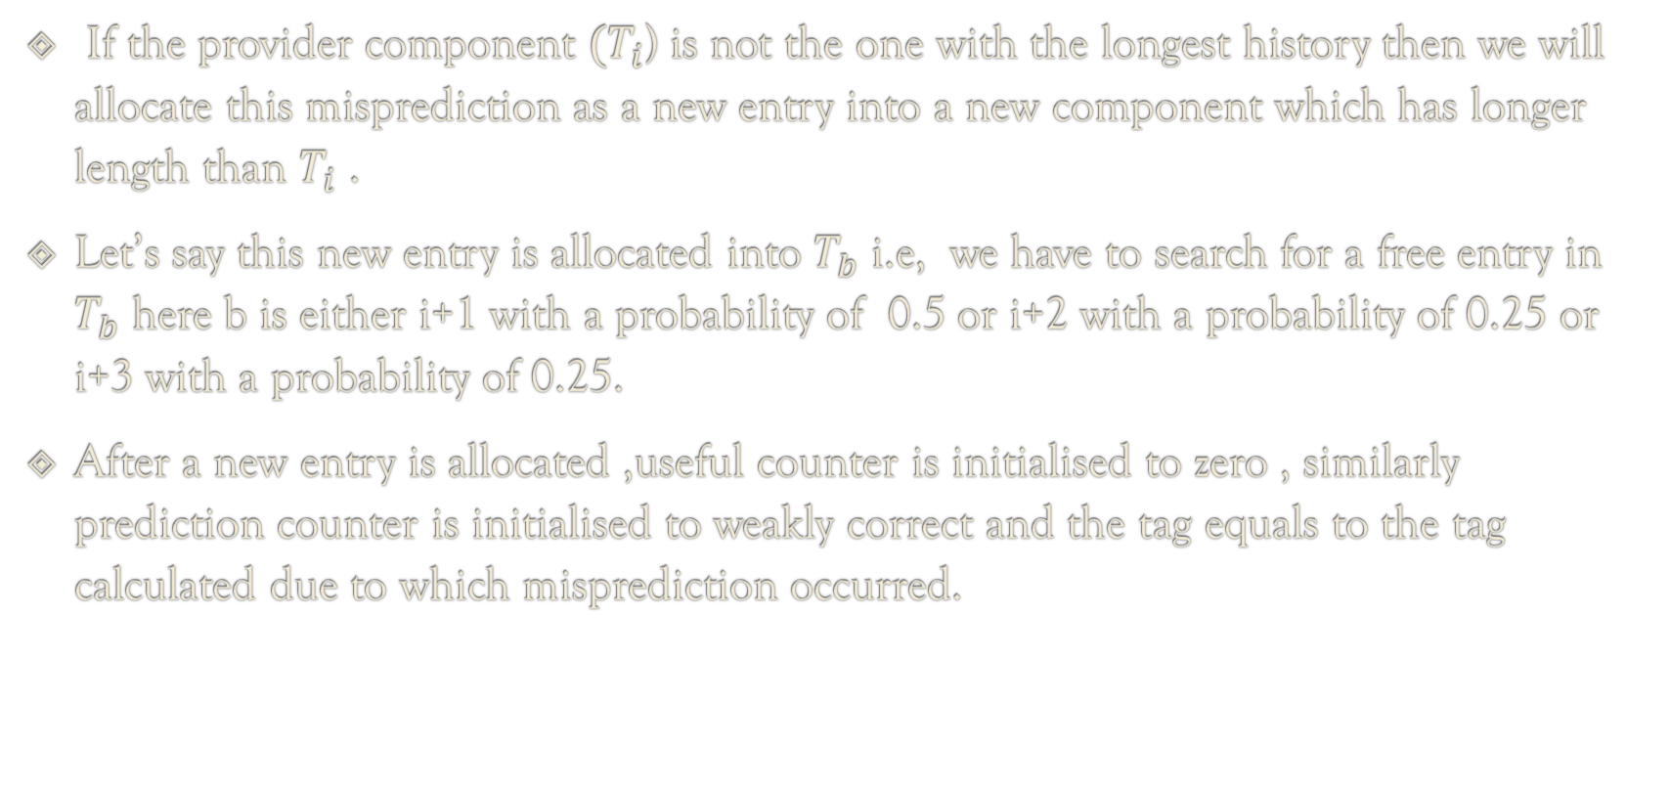
Where to allocate the mispredictions?
If the provider component ${(T}_{i}$) is not the one with the longest history then we will allocate this misprediction as a new entry into a new component which has longer length than $T_{i}$ .
Let’s say this new entry is allocated into $T_{b}$ i.e, we have to search for a free entry in $T_{b}$ here b is either i+1 with a probability of 0.5 or i+2 with a probability of 0.25 or i+3 with a probability of 0.25.
After a new entry is allocated ,useful counter is initialised to zero , similarly prediction counter is initialised to weakly correct and the tag equals to the tag calculated due to which misprediction occurred.

Slide 15
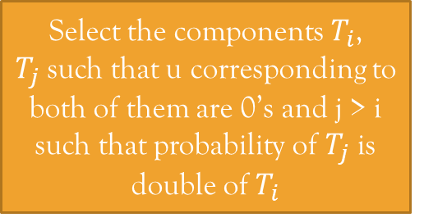
Not taken
Predict an outcome of branch
taken
Update prediction counter
Update prediction counter
Collect all the pointers to u’s for the same tag in all the components which have length greater than the predictor component
Select the components $T_{i}$, $T_{j}$such that u corresponding to both of them are 0’s and j > i such that probability of $T_{j}$ is double of $T_{i}$
Decrement all u’s in the collected set
No 0’s
Check if there are any u’s in the collection that are 0?
Multiple 0’s
Unique 0
Change that entry to a newly allocated entry but change the tag to the tag of the branch
Change that entry to a newly allocated entry but change the tag to the tag of the branch

Slide 16
Personal Modifications to Tage Predictor
In case of misprediction , while checking for components having usefulness non zero for the given address are multiple , then we have to select a single component out of all these possibilities .
Instead of selecting the components with usefulness zero , we have selected all the components which have history length more than that of the provider component .
Among these selected components , we have divided the probability of picking the component in a geometric ratio ( taken ratio 0.5 ) .
If the picked component has usefulness zero then the new entry will be allocated here. Else we check the component which is nearer to the picked component with higher length than it, if any component exists then new entry gets allocated here . Else we check nearby component to our picked component with history length less than it , if any component exists then the new entry gets allocated here .

Slide 17
Tage Predictor Improvement
If no such components exists with usefulness zero then the usefulness value of all the components decremented . All these above implementations wereimplemented inside the rand_func( ) function .
Yippee ! In some cases our personal modification to tage predictor produces higher branch prediction rate than the original tage predictor . This is because tage is not considering the probability values for the components with usefulness non-zero it only distributes the probability among the components with usefulness zero
But our modification to tage predictor considers all the components greater than provider component and picks the component with usefulness zero nearer to the selected component ( returned by rand_func( ) function written in the code ) .

Slide 18
Can we do better ?
If there is a loop which is nested within another loop that iterates 1000 times, the behavior of the branch instruction becomes more complex and harder to predict. In this case, the TAGE algorithm may have difficulty making accurate predictions, as it does not take into account the behavior of the outer loop .
What If we use a separate history table to store the history of the outer loop and use this information to make further more accurate predictions ?
This is how LTAGE (Loop TAgged GEometric) predictor is born.
LTAGE has an advantage over TAGE , it reduces the burden on the constrained memory of TAGE because LTAGE uses a smaller set of prediction tables than TAGE.

Slide 19
IMPROVED TAGE BRANCH PREDICTOR ( LTAGE )
Improved Tage branch predictor which is also called as LTAGE branch predictor , a variant of TAGE branch predictor.
The only difference is that in our improved version of TAGE predictor we include loop predictor along with the TAGE predictor.

Slide 20
Loop Predictor
Our loop predictor simply tries to identify regular loops with the constant number of iterations ( i.e. repetitive for and while loops ) .
Our loop predictor gives a global prediction when the loop is executed 3 times with the same number of iterations .
Loop Predictor contains a table with 256 entries and each entry is of length 52 bits , out of which 14 are for past iteration counter , 14 are for current iteration count , 14 are for partial tag , 2 are for confidence on our prediction and 8 for the age counter .
The entry will be replaced only when the age counter is zero, initially age counter is set to 31 .
Age is reset to zero when the branch is determined as not being regular .

Slide 21
Update Policy in Loop Predictor
Step 1:
We calculate the index, tag for a given address and finally check whether the tag is a hit or a miss . Then compute the prediction from the loop predictor .
Step 2:
If the loop prediction is not same as the actual result and it is a hit , then the counter is updated based on the actual result .
If it is a miss then a new entry is created in the loop prediction table .
If the loop prediction is same as the actual result , if it is a hit then the counter of the entry is increased and if the number of iterations has the value 0 , then a new entry is created and number of iterations is increased .
Step 3:
If it is a hit and the counter is in a strong state , then the confidence of the entry is increased and the confidence decreases in the case of counter being in weak state .
In any other case , the confidence of the entry is changed to zero.
Step 4:
Finally, we update the global and path history along with the counter of the entry is changed according to the actual result .

Slide 22
What to choose loop/TAGE in our LTAGE?
Generally , we prefer Loop predictor over TAGE predictor for the final prediction in cases where repetitive for and while loops with same number of iterations were present .
Well there are exceptions, they are
If (confidence of the loop predictor < 3) then choose TAGE over Loop predictor for the final prediction .
Else the Loop predictor is chosen over TAGE predictor .

Slide 23
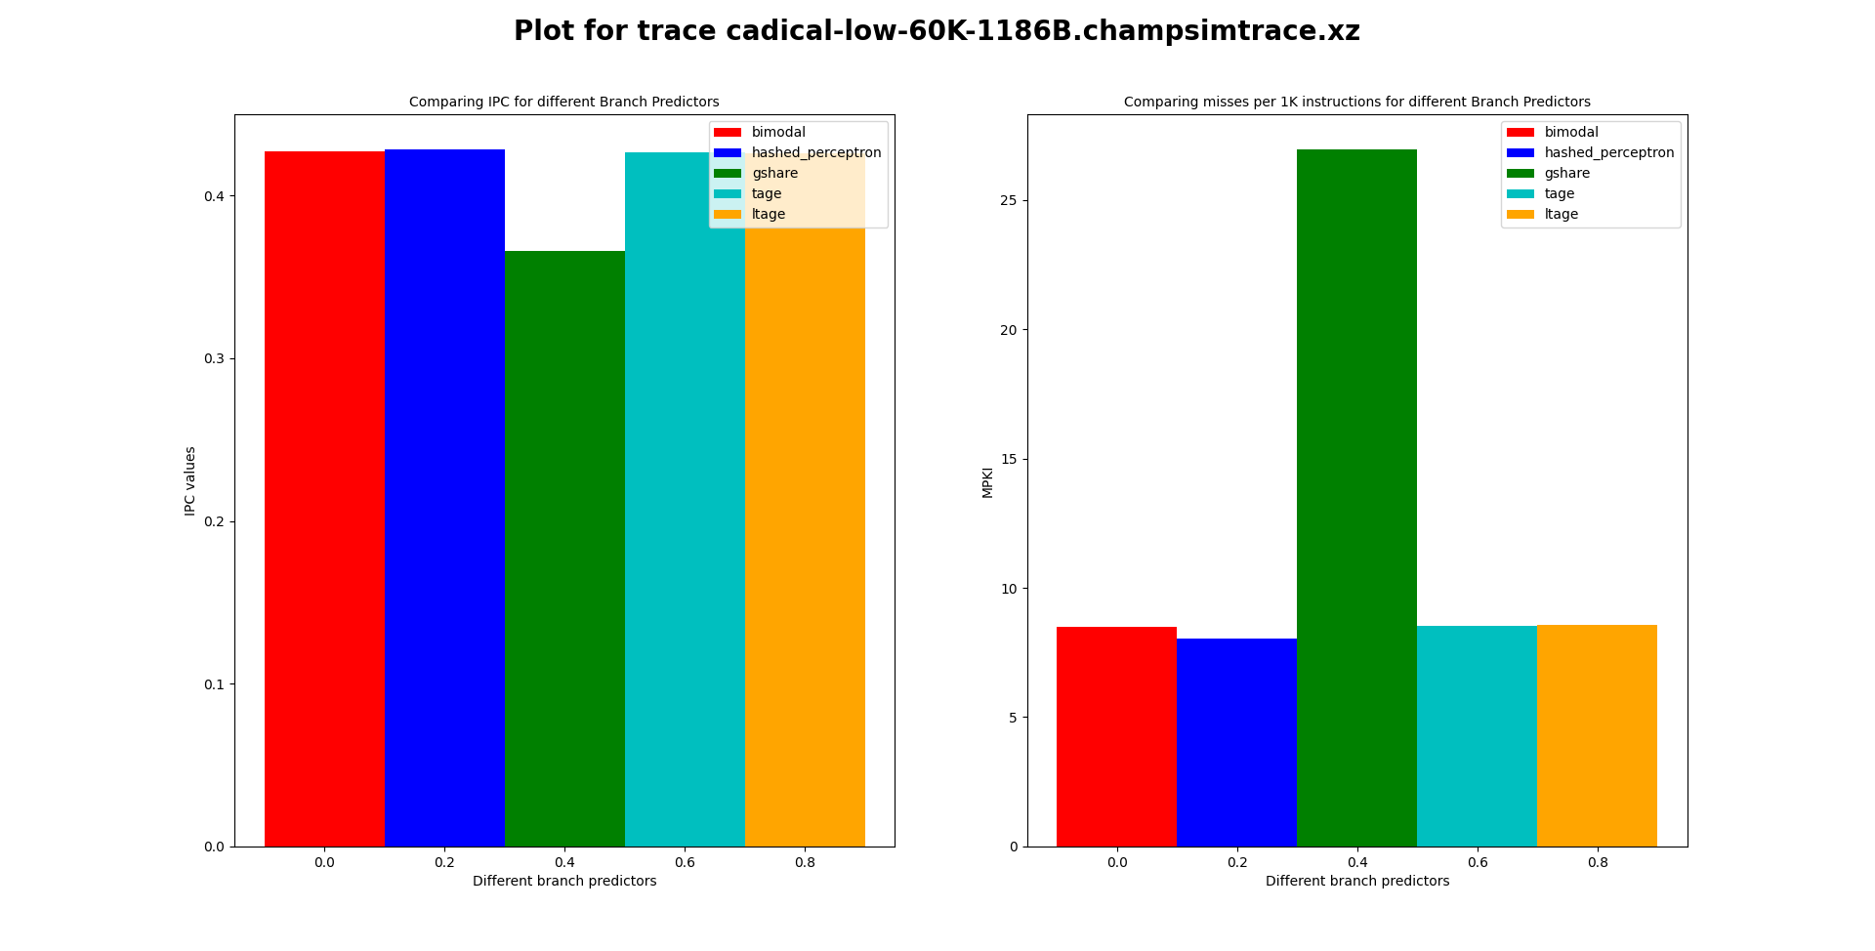
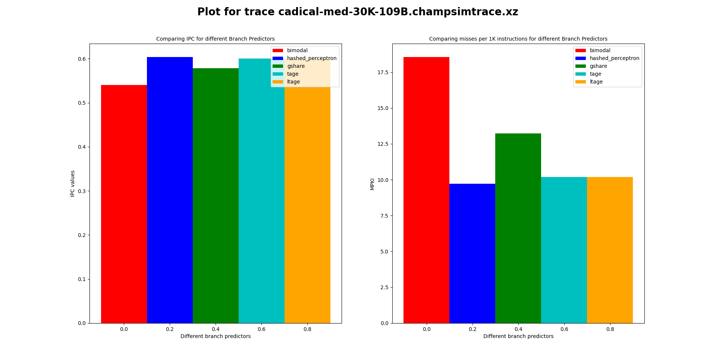

Slide 24
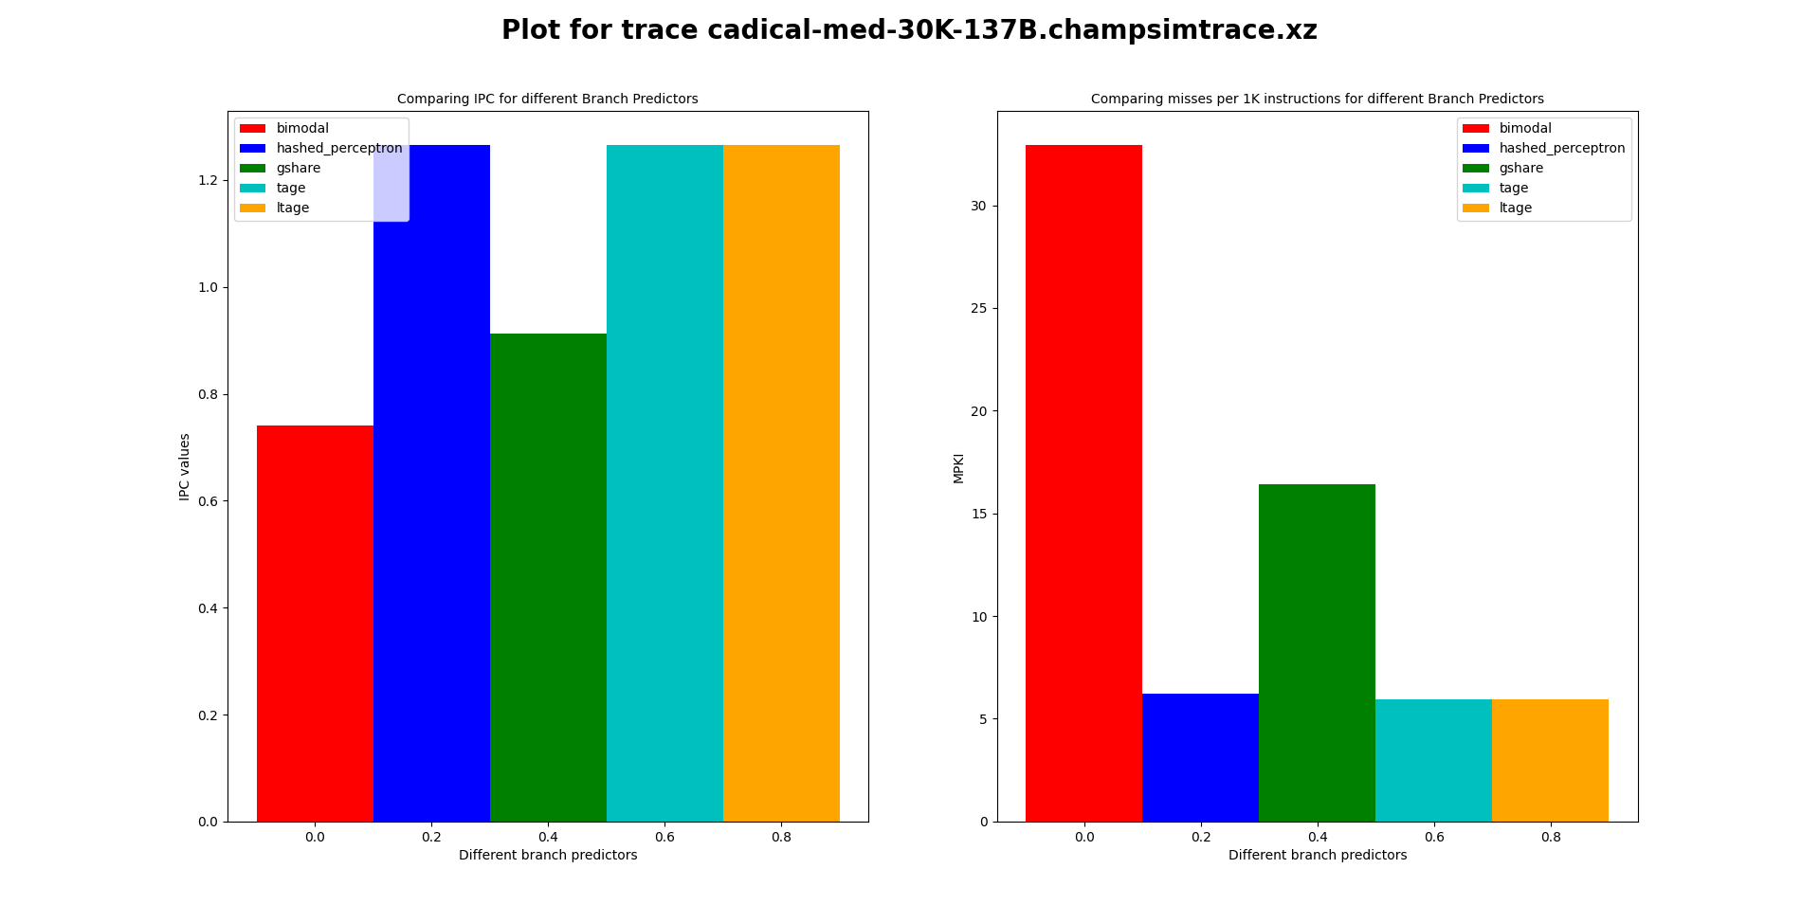
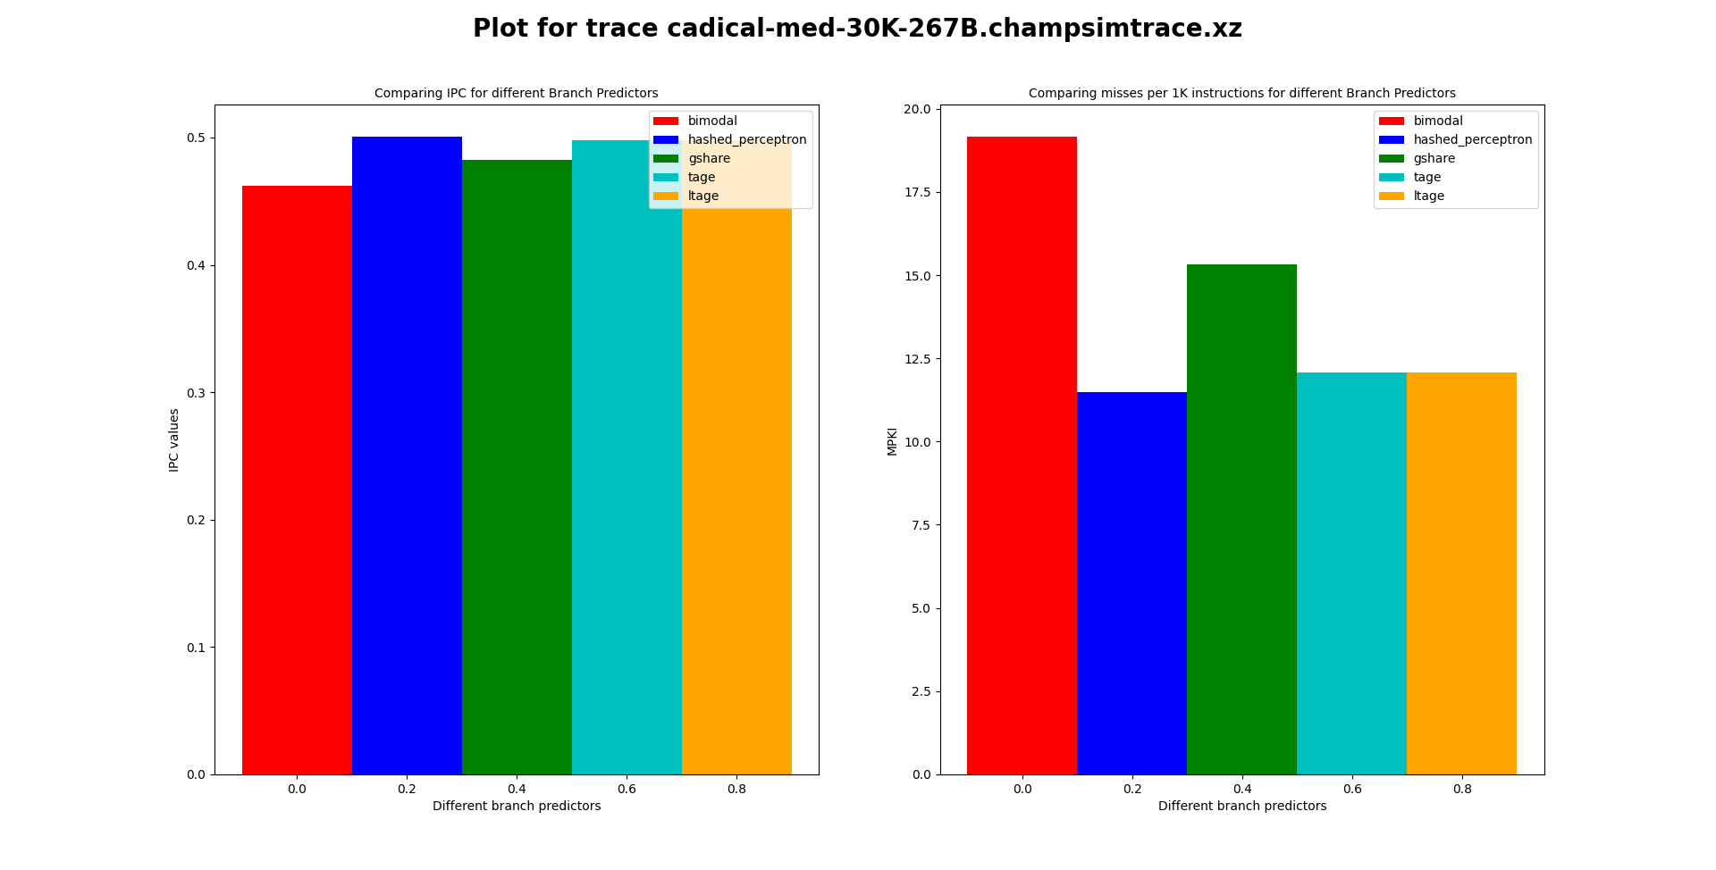

Slide 25
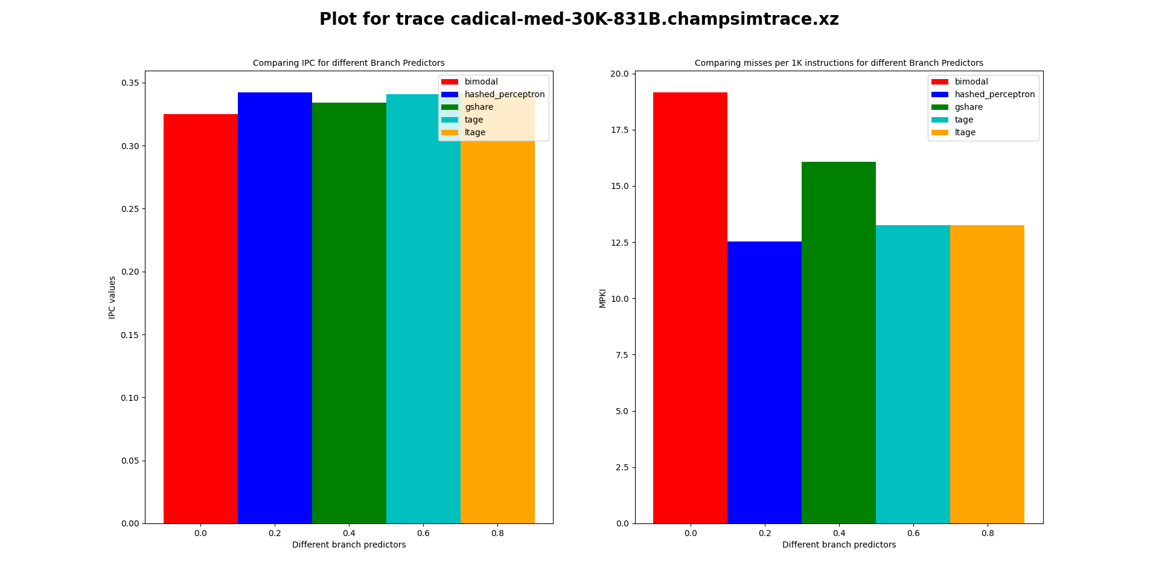
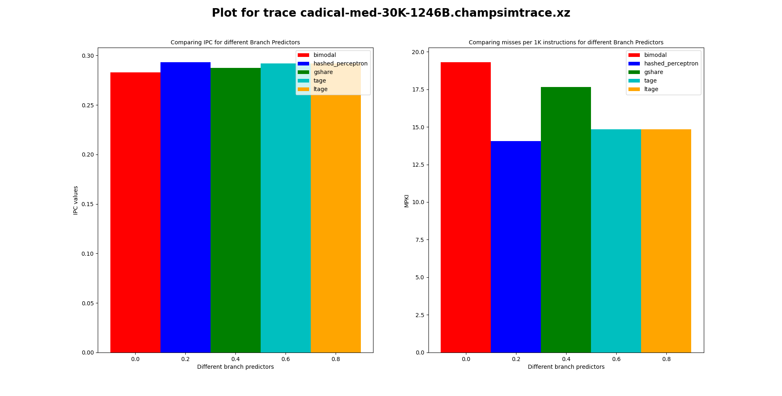

Slide 26

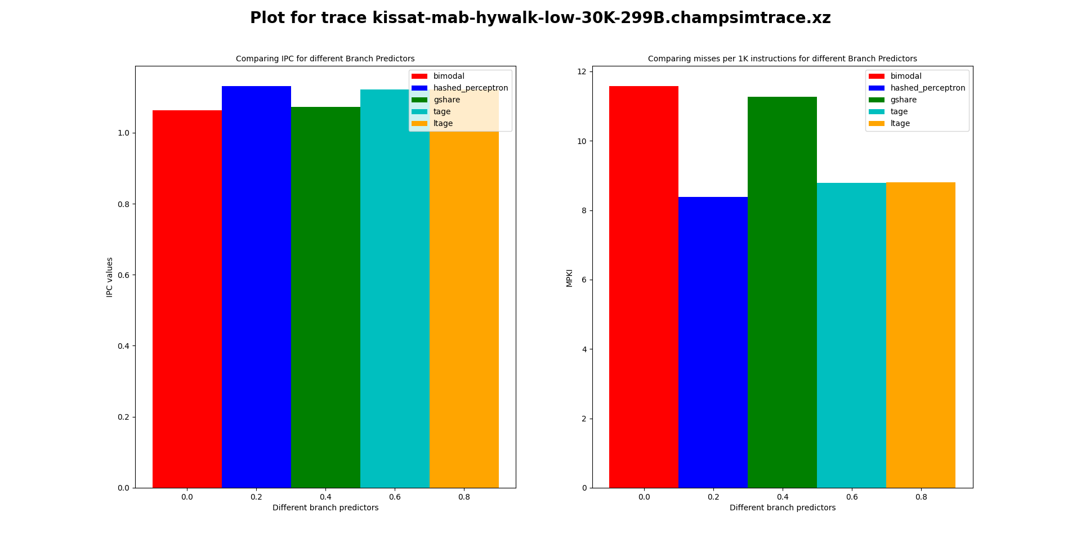

Slide 27
Comparing Predictors
Our Improved TAGE predictor ( ltage ) ,TAGE predictors are better than most of the predictors which we have chosen , sometimes hashed perceptron performs better than them .
Sometimes , hashed perceptron performs better than tage and its variant , because of
Memory constraint as it uses single table to store the weight vector ,instead of using multiple tables like TAGE .
Non stationary branches (whose behaviour change over time) i.e. hashed perceptron can adopt to changes quickly .

Slide 28
Comparing Predictors
Hashed perceptron reduces the memory requirements of the perceptron algorithm by using hash functions to select a small subset of perceptron weights to update .
Tage requires a large amount of memory to store the predictors and their history, which can be a significant drawback for systems with limited memory .
Hashed perceptron may not perform well , because of the use of hashed functions which means that different inputs may be mapped to same set of weights, leading to incorrect predictions .
Tage uses multiple predictors with different history lengths, allowing it to adapt to different types of branches and patterns in the program .
hashed perceptron can handle-dimensional input spaces efficiently .
Tage can predict conditional branches with a high degree of accuracy, reducing the number of mispredictions and improving program performance .

Slide 29
Thank You !
TEAM VVK

